Slide 1
Mall Navigation System
Project Guide : Ms.Dhanya
BCA GROUP 4
Anushka M | 19USCA01
Honey sunny | 19USCA21
Arun Augustin | 19USCA07
Department Of Computer Science
ST.JOSEPH’S COLLEGE ,DEVAGIRI

Slide 2
Index
Introduction
About our project
Module description
DFD
ER diagram
Table design
Input/Output form design

Slide 3
Introduction
The proposed system is used to navigate through shopping malls .A network of devices is used to give turn-by-turn directions to locations or objects where GPS and other technologies cannot work.
Proximity marketing ,viewing vacant spaces of the shopping mall and car parking tracker are the other features of the system.

Slide 4
About our project
A navigation system that helps the customer locate themselves inside the mall and get to the desired shop or service using indoor mobile localization .
After current location is pinpointed the path to the destination is determined and is communicated to the user ,while giving live directions based on the change in the location of the user.

Slide 5
A voice assistant is provided for visually disabled users, the app can also set to be activated when the volume button is pressed thrice.
An alert of the offers in nearby shops will be given according to the location of the user

Slide 6
Module Description
There are total four modules :
Admin
Shopping Mall
Shop
User

Slide 7
Admin
In this module Admin is one who manages the entire working of the system. Following are the main functions that can be performed by the Admin :
View and verify shopping mall
View complaints and actions taken by the shop/shopping mall
View rating and feedback

Slide 8
Shopping Mall
The registered shopping mall can have the following functions :
View complaints and action taken by the shop
View rating and feedback
Add and manage rooms
View request
Add or manage hotspot
Allocate hotspot

Slide 9
Shop
Shops can have the following functions :
Add and manage products and offers
View complaints and sent replies
View rating and feedback
Requesting available rooms
View status of the room

Slide 10
User
The customers can have the following functions :
View product and offers
Rate and feedback
Sent complaint
Navigation
Parking
View complaints and replies
View vacant spaces

Slide 11
DFD

Slide 12
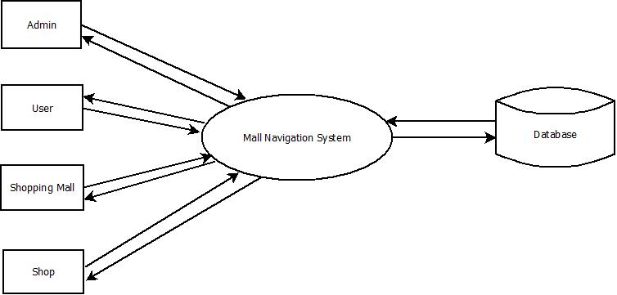
Level 0

Slide 13
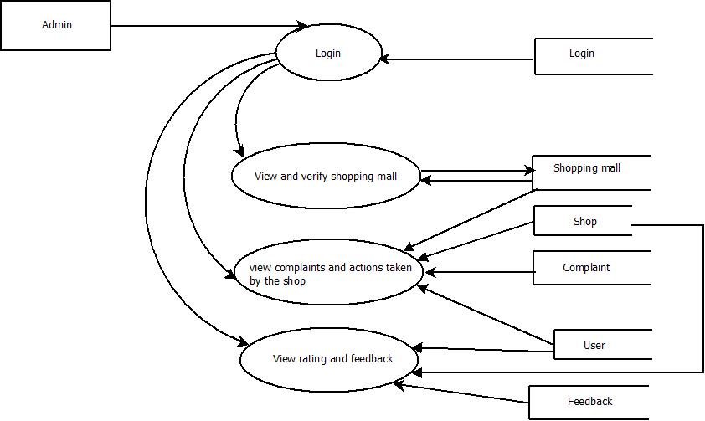
Level 1

Slide 14
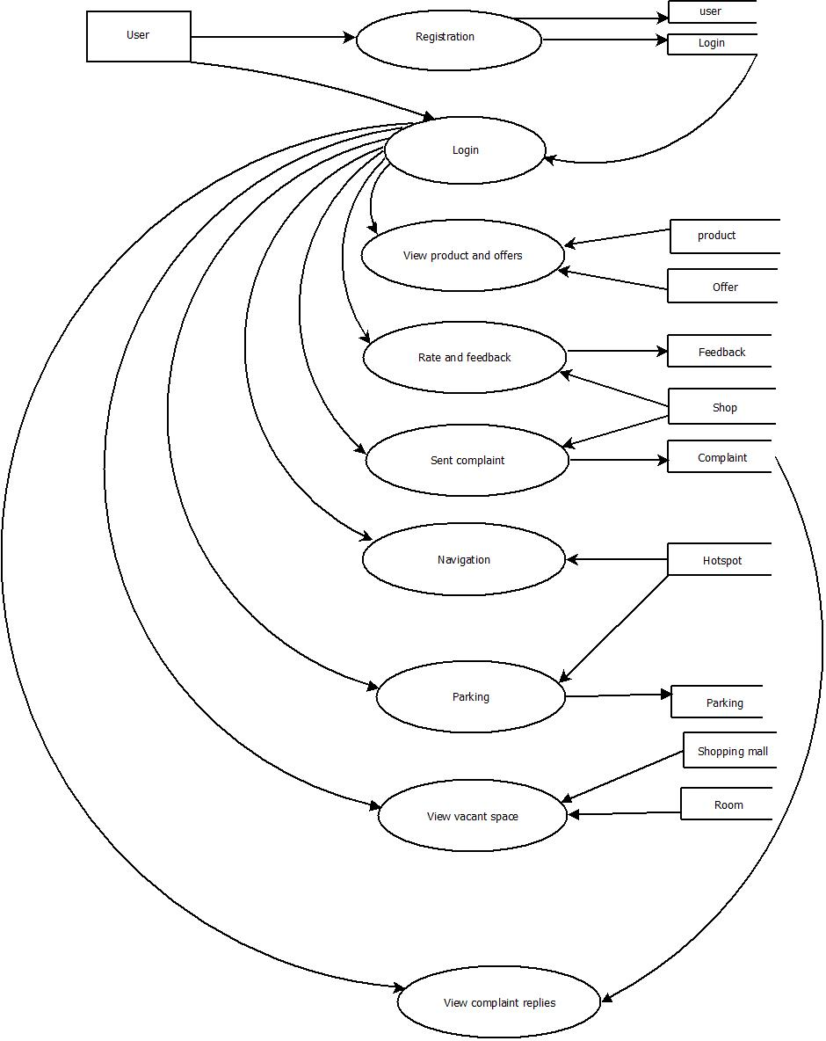
Level 2

Slide 15
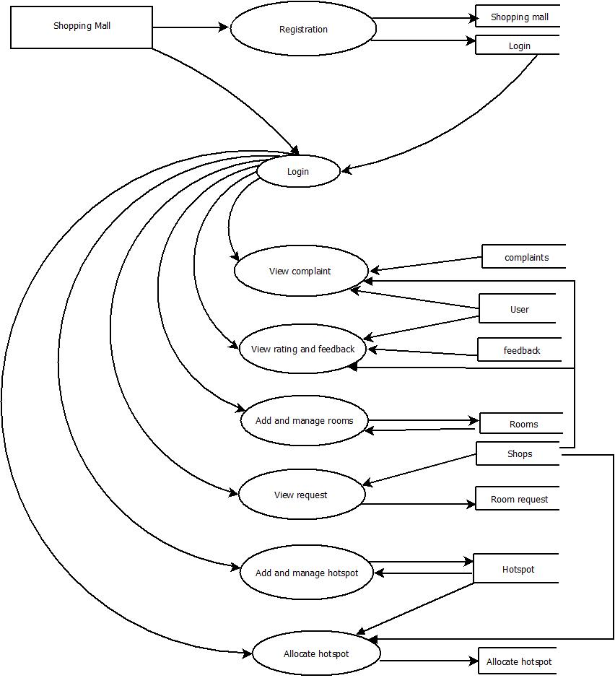
Level 3

Slide 16
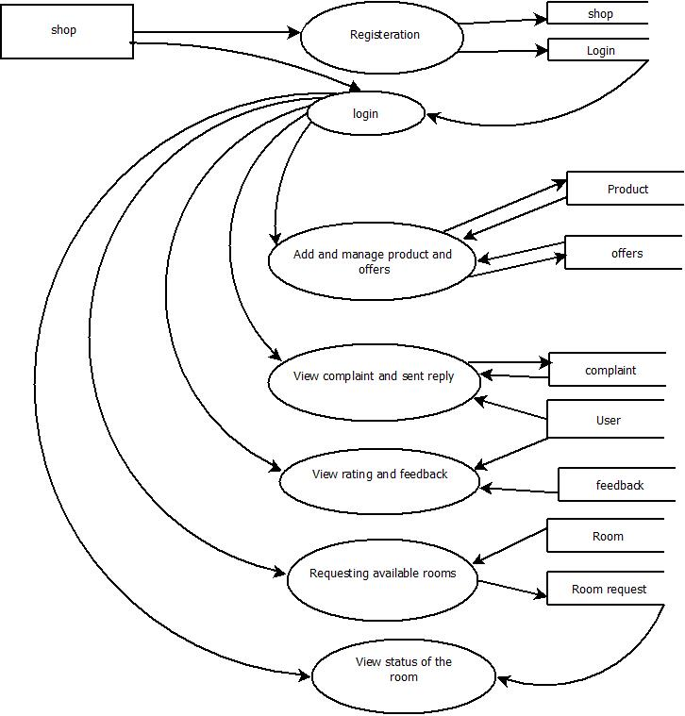
Level 4

Slide 17
ER DIAGRAM

Slide 18
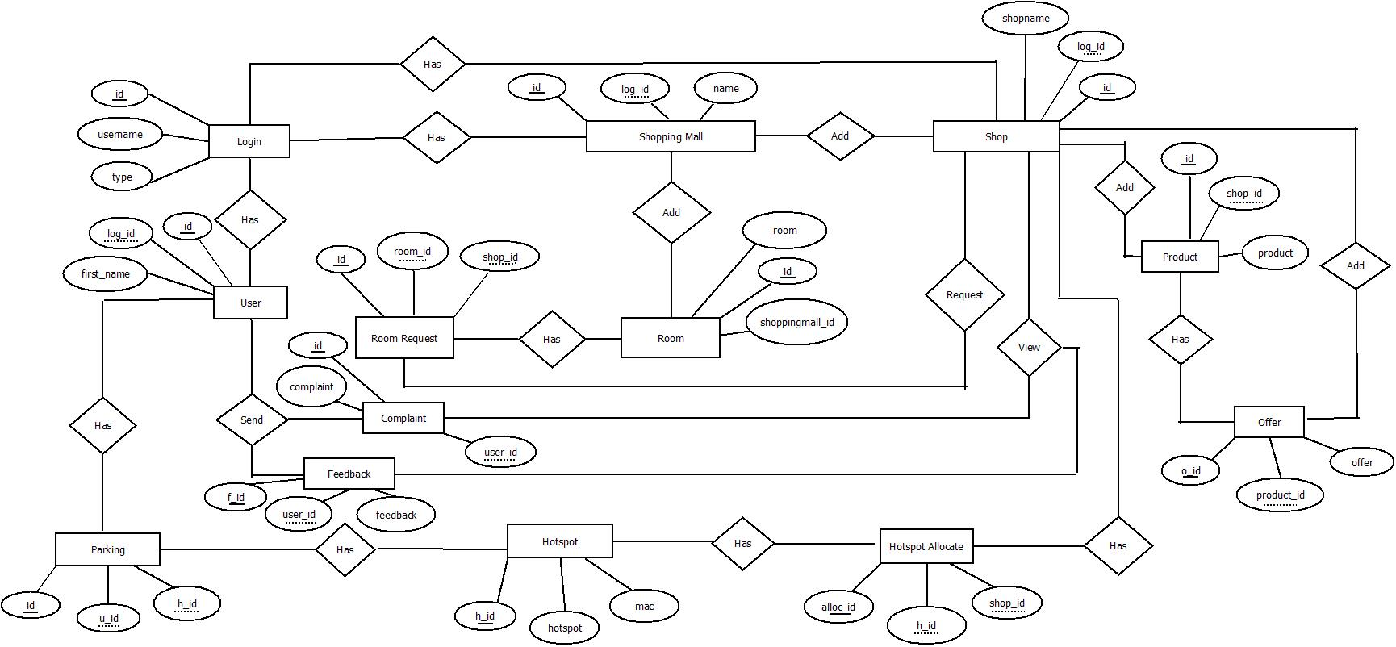

Slide 19
DATABASE DESIGN

Slide 20
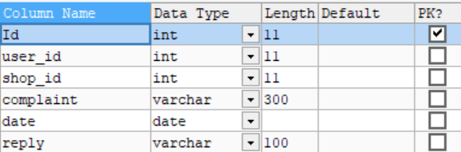
Complaints

Slide 21
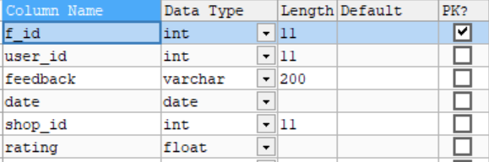
Feedback

Slide 22
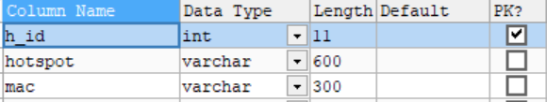
Hotspot

Slide 23
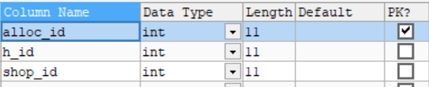
Hotspot allocation

Slide 24
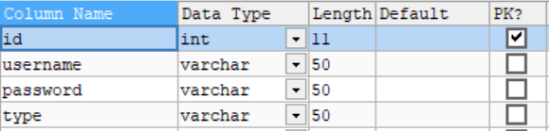
Login

Slide 25
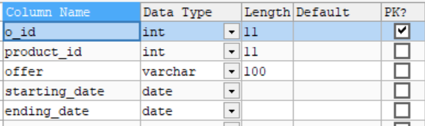
Offers

Slide 26
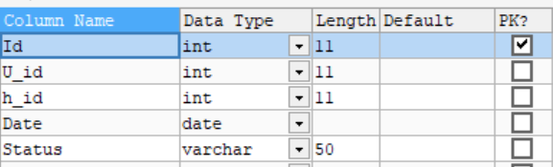
Parking

Slide 27
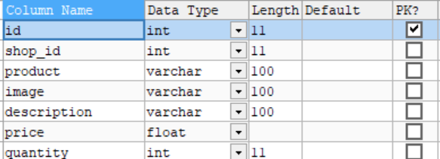
Product

Slide 28
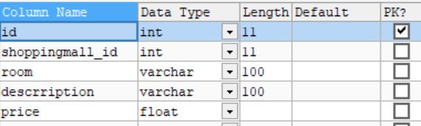
Room

Slide 29
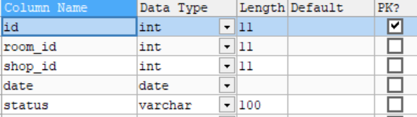
Room request

Slide 30
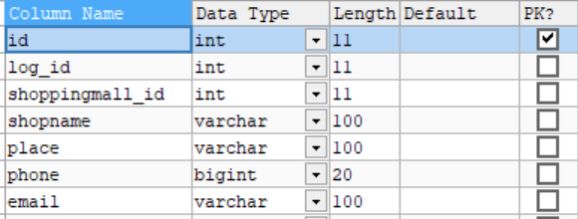
Shop

Slide 31
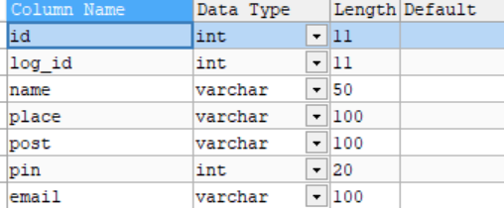
Shopping mall

Slide 32
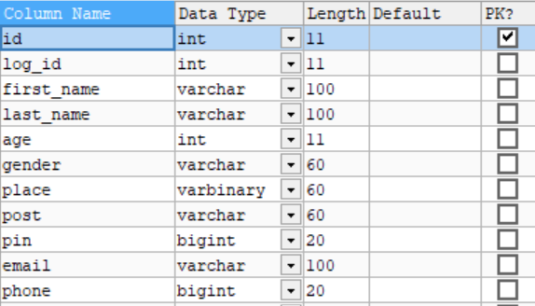
User

Slide 33
Input Form Design

Slide 34
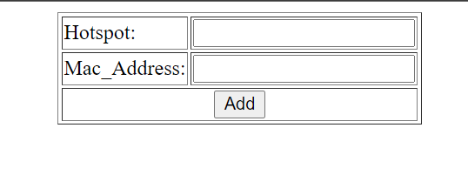
Add hotspot

Slide 35
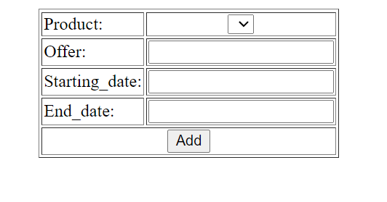
Add offers

Slide 36
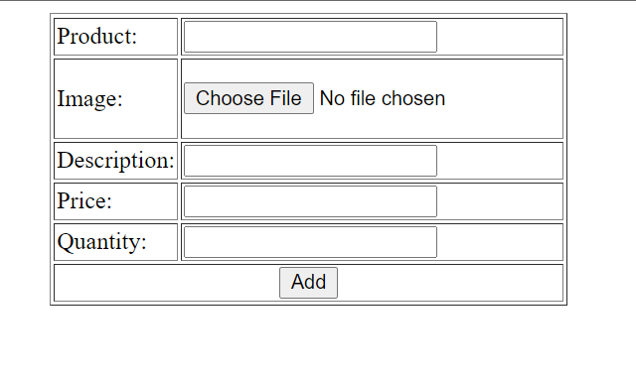
Add product

Slide 37
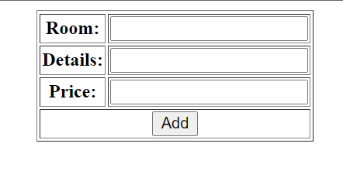
Add room

Slide 38
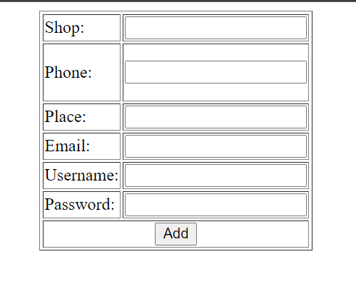
Add shop

Slide 39
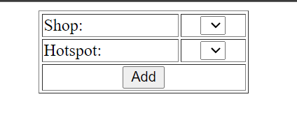
Allocate Hotspot

Slide 40
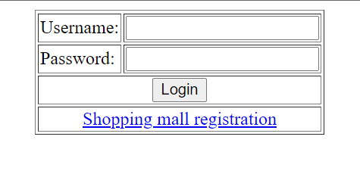
Login

Slide 41
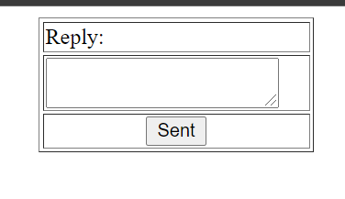
Send reply

Slide 42
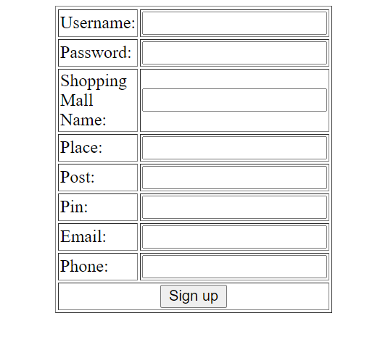
Shopping mall registration

Slide 43
Output Form Design

Slide 44
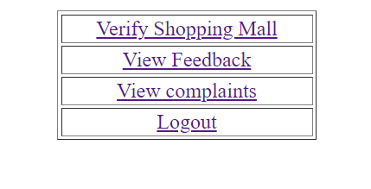
Admin home

Slide 45
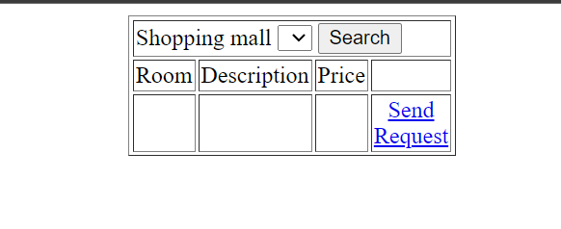
Available rooms

Slide 46
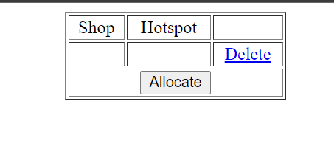
Manage allocated list

Slide 47
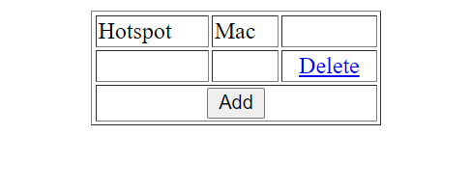
Manage hotspot

Slide 48
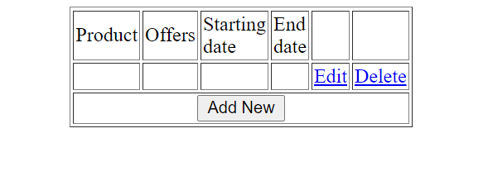
Manage offers

Slide 49
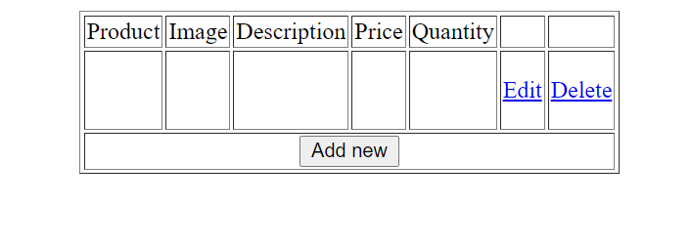
Manage product

Slide 50
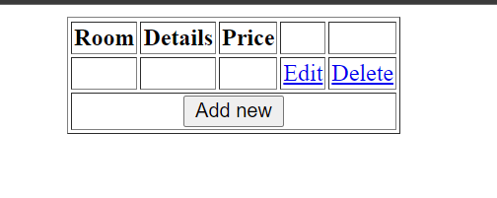
Manage rooms

Slide 51
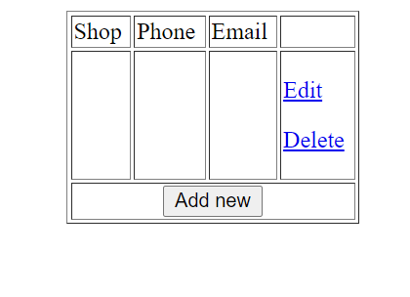
Manage shops

Slide 52
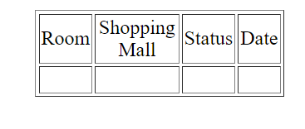
Request status

Slide 53
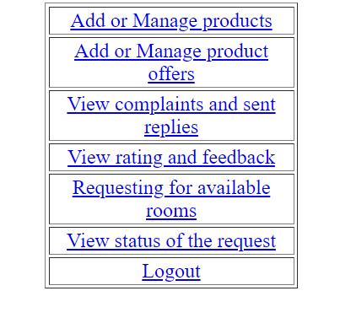
Shop home

Slide 54
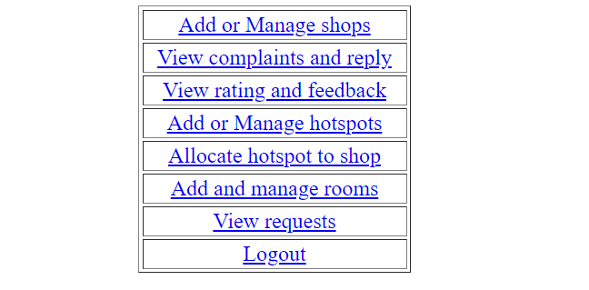
Shopping mall home

Slide 55
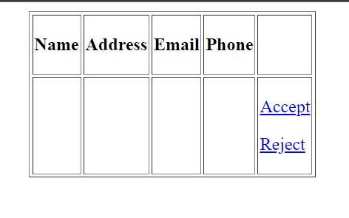
Verifying shopping mall

Slide 56
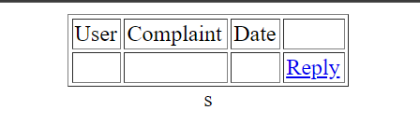
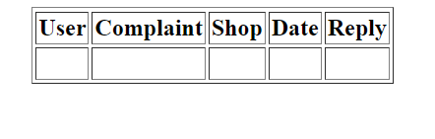
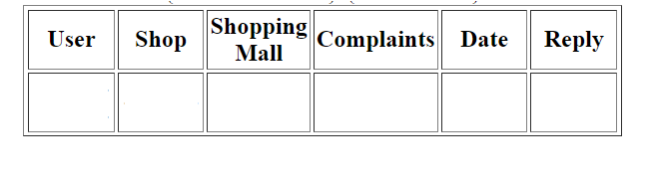
View complaints and replies

Slide 57
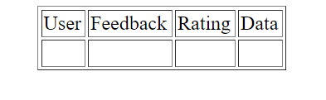
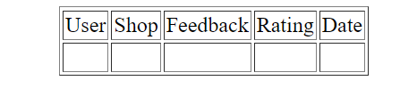
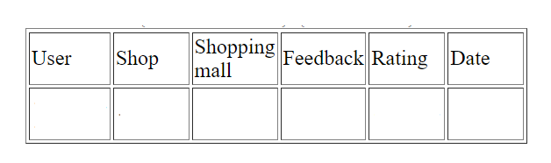
View feedback and rating

Slide 58
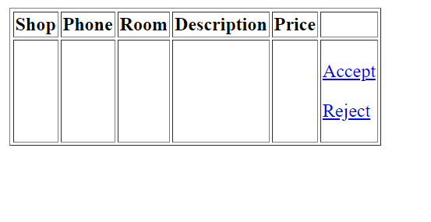
View request

Slide 59
THANKYOU!

